Slide 1
Light GBM

Slide 3
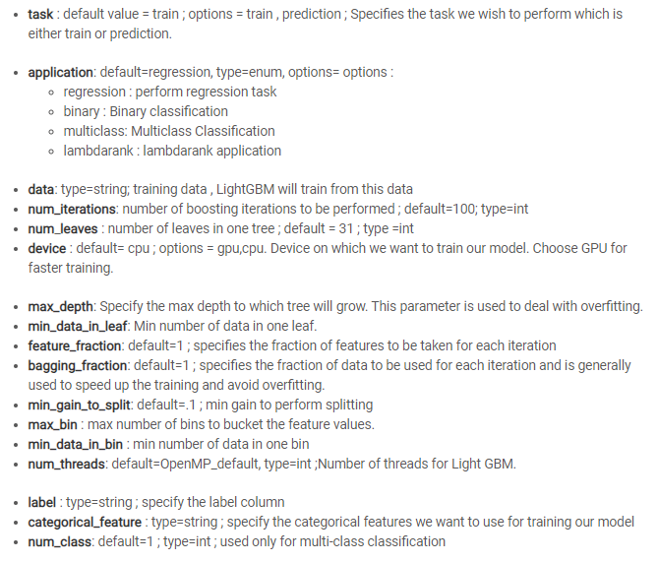
Important Parameters

Slide 4
Algorithm introduction
It is a gradient boosting framework, considered to be a fast processing algorithm that makes use of tree-based learning.

Slide 5
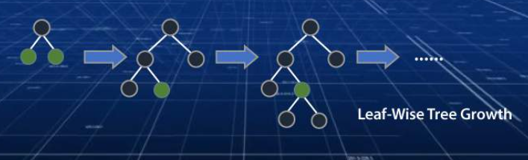
While other algorithms trees grow horizontally, LightGBM algorithm grows vertically meaning it grows leaf-wise and other algorithms grow level-wise. LightGBM chooses the leaf with large loss to grow. It can lower down more loss than a level wise algorithm when growing the same leaf
It can easily overfit small data due to its sensitivity. It can be used for data having more than 10,000+ rows.

Slide 6
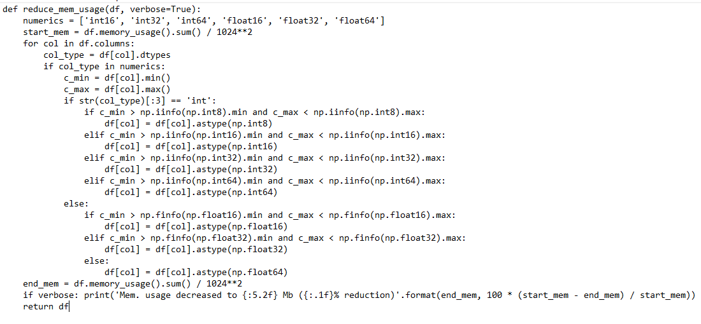
Shrinking input

Slide 7
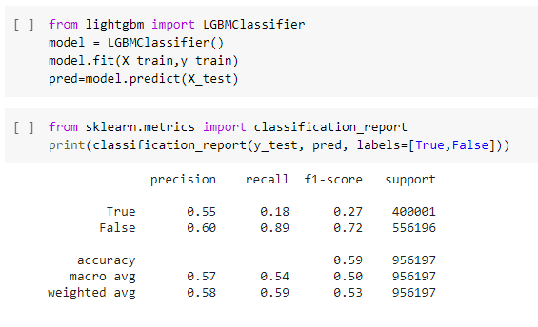
output

Slide 8
Predicting the SP500 Index Trend Based on GBDT and LightGBM Methods https://doi.org/10.1051/e3sconf/202021402019
based on the SP500 index data for 4936 trading days, 10 characteristics such as PSY, MACD, STOCHK and STOCHD were generated.
In this paper, the statistics of the SP500 index over the past 4936 days were used as input, and a LightGBM and GBDT algorithm model was established to predict the future index change.

Slide 9
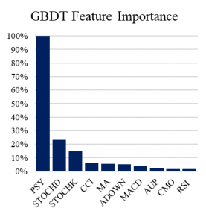
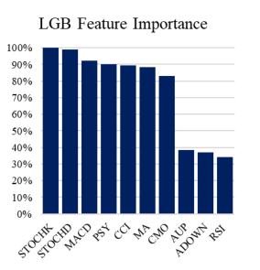
Feature importance of GBDT and LightGBM
The LightGBM model can
utilize each feature in a balanced manner. If the accuracy
of the model needs to be improved, adding new features
is a solution.

Slide 10
Conclusion reached by the paper
In terms of model accuracy, the F1 score of the LightGBM modelwas 0.814, which was a little higher than the 0.805 of the GBDT model, indicating that the LightGBM model had higher accuracy.
After analyzing 10 features by PCA, it was found that the LightGBM model could use the ten features more evenly, so it is more suitable for complex predictions when there are multiple features.
The risk control ability of the GBDT model was a bit greater than the LightGBM model. In terms of model accuracy,

Slide 11
Advantages
Faster training speed and higher efficiency: Light GBM use histogram based algorithm i.e it buckets continuous feature values into discrete bins which fasten the training procedure.
Lower memory usage: Replaces continuous values to discrete bins which result in lower memory usage.
Better accuracy than any other boosting algorithm: It produces much more complex trees by following leaf wise split approach rather than a level-wise approach which is the main factor in achieving higher accuracy. However, it can sometimes lead to overfitting which can be avoided by setting the max_depth parameter.
Compatibility with Large Datasets: It is capable of performing equally good with large datasets with a significant reduction in training time as compared to XGBOOST.
Parallel learning supported.
Slightly more accurate than XGboost but a lost faster to train.

Slide 12
Notebooks that does tuning
Tuning:
https://www.kaggle.com/satorushibata/lightgbm-classifier-pca-logit-on-utility-score/notebook#LightGBM-Training
Base model:
https://www.kaggle.com/daisyrhea97/lightgbm-weight-resp
https://www.kaggle.com/danielginsburg613/lgbm-model

